Slide 1

Pattern Matching
JavaScript

Slide 2
/pattern/modifier
Find all matches rather then stopping after the first match.
Find case sensitive character .
Find multiline matching

Slide 3
Method for Searching or Find pattern
match()
search()
exec()
test()
This method is define array of string
otherwise null return
This method return character position otherwise -1 return
This method return array otherwise null return
This method return true otherwise false return

Slide 4
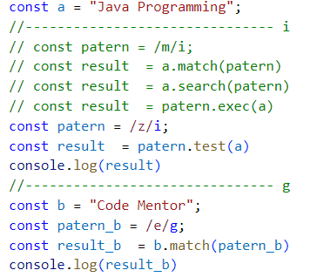
match()
search()
exec()
test()

Slide 5
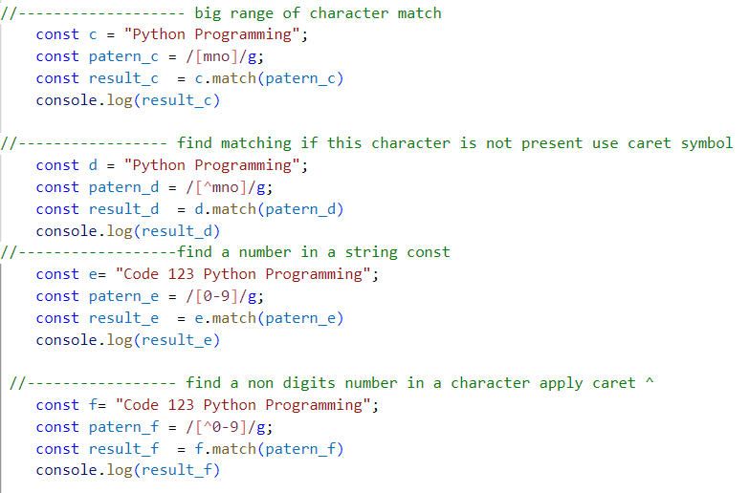
[ ]
Range of Character
^
Caret Symbol

Slide 6
Meta Character
\d | find the digit
\D | find the non digit
\w | find the word character
\W | find a non word character
\s | find a white space character
\S | find a non white space character
\. | find a single line character

Slide 7
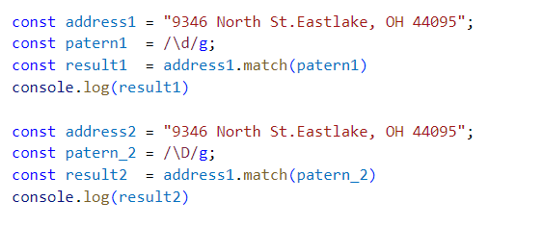
\d
\D

Slide 8
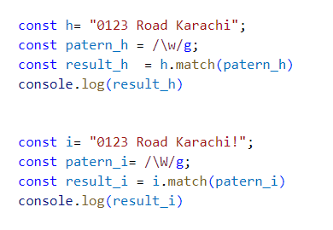
\w
\W

Slide 9
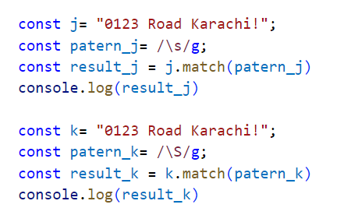
\s
\S

Slide 10
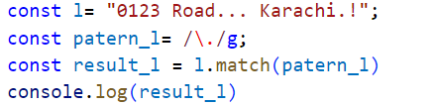
\.

Slide 11
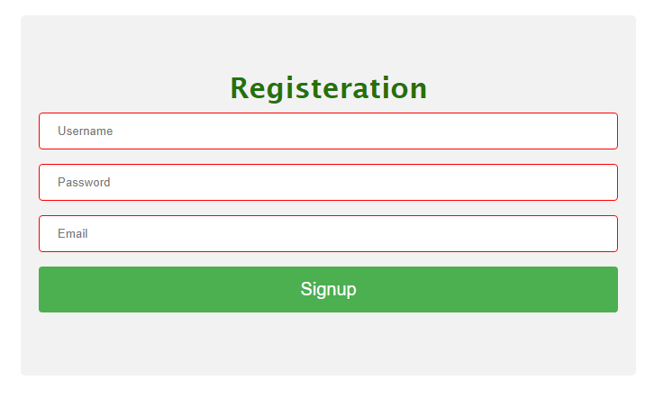
Exercise – Form validation

Slide 12
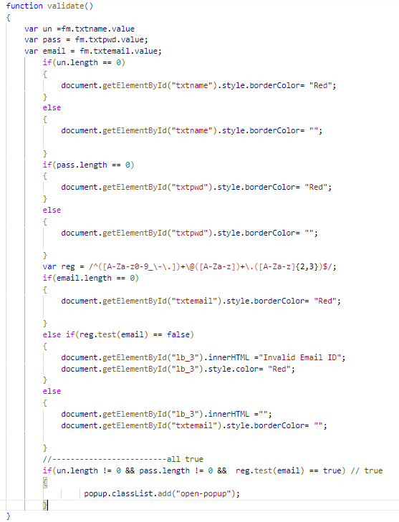
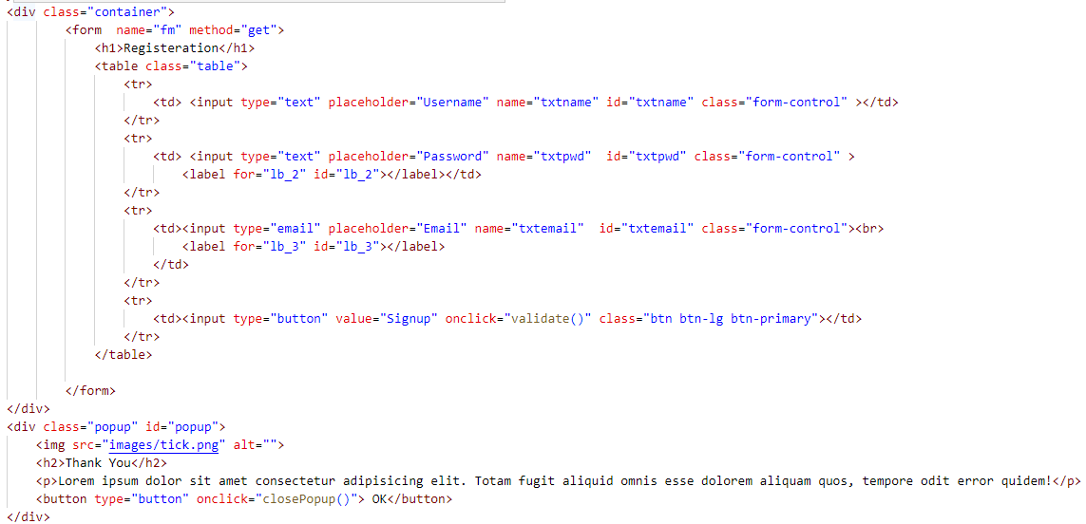
^[a-zA-Z]\w{3,14}$/
/^([A-Za-z0-9_\-\.])+\@([A-Za-z])+\.([A-Za-z]{2,3})$/

Slide 13
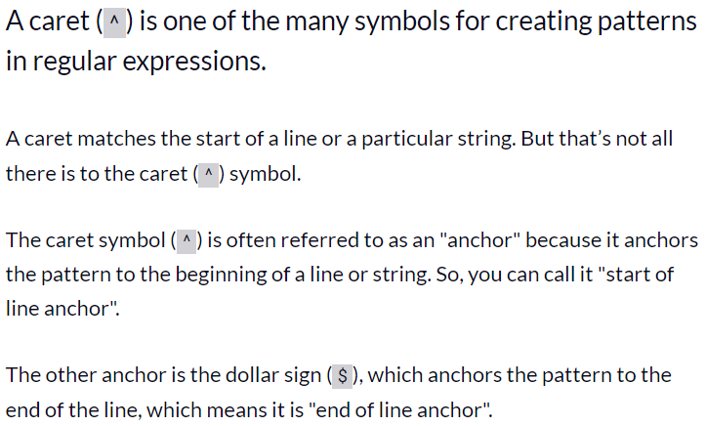
What Does the Caret Mean in RegEx? Caret Metacharacter in Regular Expressions

Slide 14
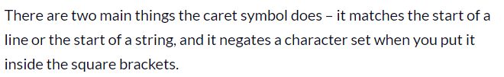
What Does the Caret Symbol Do in RegEx?

Slide 15
https://regexlib.com/Search.aspx
https://regex101.com/

